Slide 1





Digital flashcards
Teacher lesson guide
Lesson 1

Slide 2
Learning objectives:
To know and understand what algorithms are.
To write algorithms with clear instructions.
To test and debug algorithms.

Slide 3
Using Flashcards
In pairs, use the flashcards to practice your language.
Swap roles so you take on both roles.

Slide 4
Creating Algorithms
What do you know about algorithms?
How have you previously used them?
An algorithm is a set of sequenced instructions, steps or rules for a human to follow to solve a problem or complete a task.

Slide 5
Responder algorithm
What sequence of steps did you take as ‘responder’?

Slide 6
Testing our Algorithm
How can we test our algorithm?
What is finding and fixing errors called?
Notes:
.

Slide 7
‘Shower’ algorithm
In pairs, write an algorithm that will instruct someone how to be the flashcard ‘shower.’
Test and debug your algorithm as you write it.

Slide 8
Testing our algorithms
How can we test if our algorithms work?
Why is it important to test our algorithms?

Slide 9
Testing our algorithms
Follow the algorithm you have written to use the flashcards.
Which steps of your algorithm are the easiest to follow?
Which steps of your algorithm are the least easy to follow?

Slide 10
Learning objectives revisited:
To know and understand what algorithms are
To write algorithms with clear instructions
To test and debug algorithms

Slide 11

le pain
(bread)

Slide 12

la pomme
(apple)

Slide 13

le lait
(milk)

Slide 14

le fromage
(cheese)

Slide 15
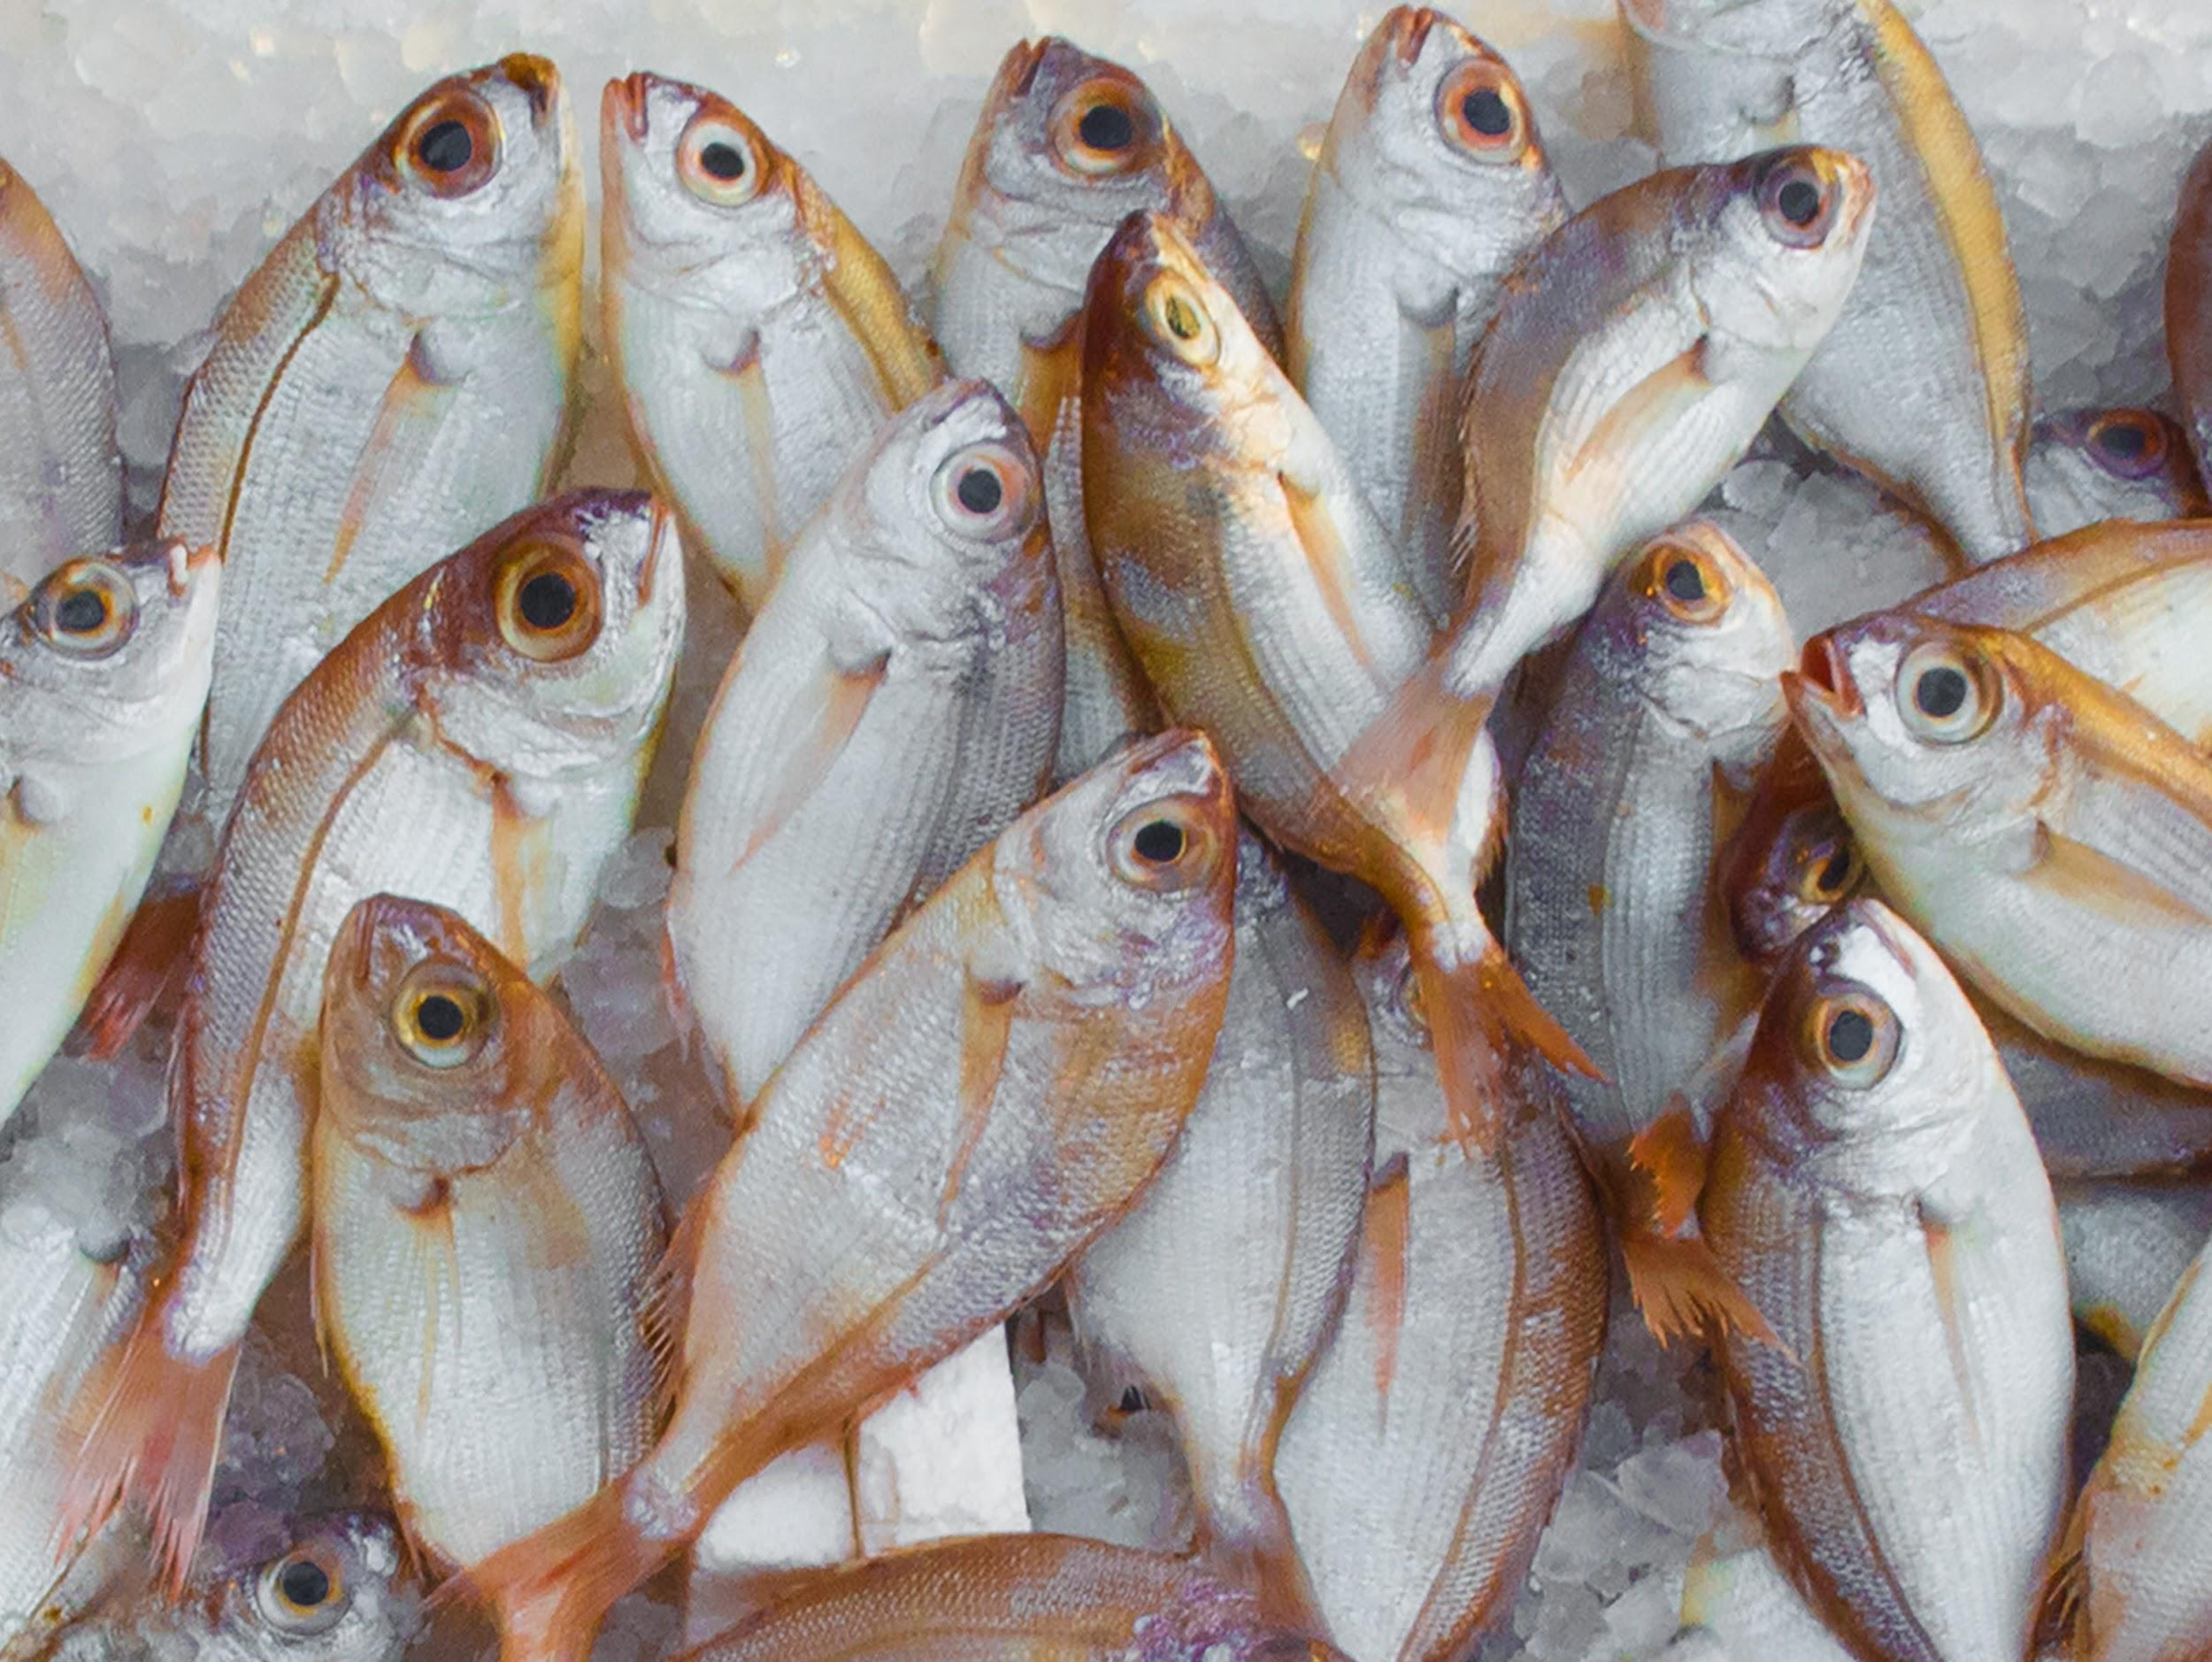
le poisson
(fish)

Slide 16
Licensing information
Published by the Micro:bit Educational Foundation microbit.org under the following Creative Commons licence:
Attribution-ShareAlike 4.0 International (CC BY-SA 4.0)
https://creativecommons.org/licenses/by-sa/4.0/

